Slide 1
UnBarred 2.0
Public Interest Research System
Notes:
Hi everyone, I’m Armaan, and today I’ll be walking you through UnBarred 2.0, our public-interest research system.
UnBarred helps researchers and advocates quickly answer complex public-policy questions by searching across messy, fragmented local laws and grounding every answer in verifiable legal text.

Slide 2





Meet the Team
Kevin Yi
Arthur Kang
Roz Huang
Armaan Hiranandani
Sammy Cayo
Notes:
10 - 20 sec intro of team

Slide 3



Problem & Why Now
Fragmented Local Codes
Manual Verification & Errors
The Solution's Impact
Local codes are fragmented across counties/cities
Verifying currency/effectivity is manual and error-prone (amendments buried in PDFs)
If solved:
faster decisions
fewer errors
broader access for legal researchers
Image source: https://www.flaticon.com/
Notes:
The core problem is that local law is extremely fragmented and hard to work with.
Local codes are scattered across dozens of county and city websites. PDFs are formatted differently, and amendments get buried deep inside long documents. Researchers often have to manually download, read, and double-check each section to see if it’s current.
That manual verification is slow and error-prone, which means important policy decisions or legal analyses can take days or weeks.
If we solve this, researchers can make faster, more reliable decisions and expand their analysis across far more jurisdictions than they can manage today.
Add some slide animations to slowly introduced each box

Slide 4



Target Users
Public-interest Researchers
Legal Analyst
Civil Advocates
Researchers who seek to conduct comparative analysis to produce large, informative research reports
Legal analyst investigating current municipal law status for legal casework and compliance reviews
Civil Advocates making public policy decisions for community projects
Image source: https://www.flaticon.com/
Notes:
Our primary users are public-interest researchers, legal analysts, and civic advocates.
Their jobs are straightforward: find the right section fast, confirm it’s current and applicable, and cite it with confidence.
Success means an answer you can trust, with the source right there, and an export you can share.
That’s the experience we’re aiming to deliver.

Slide 5
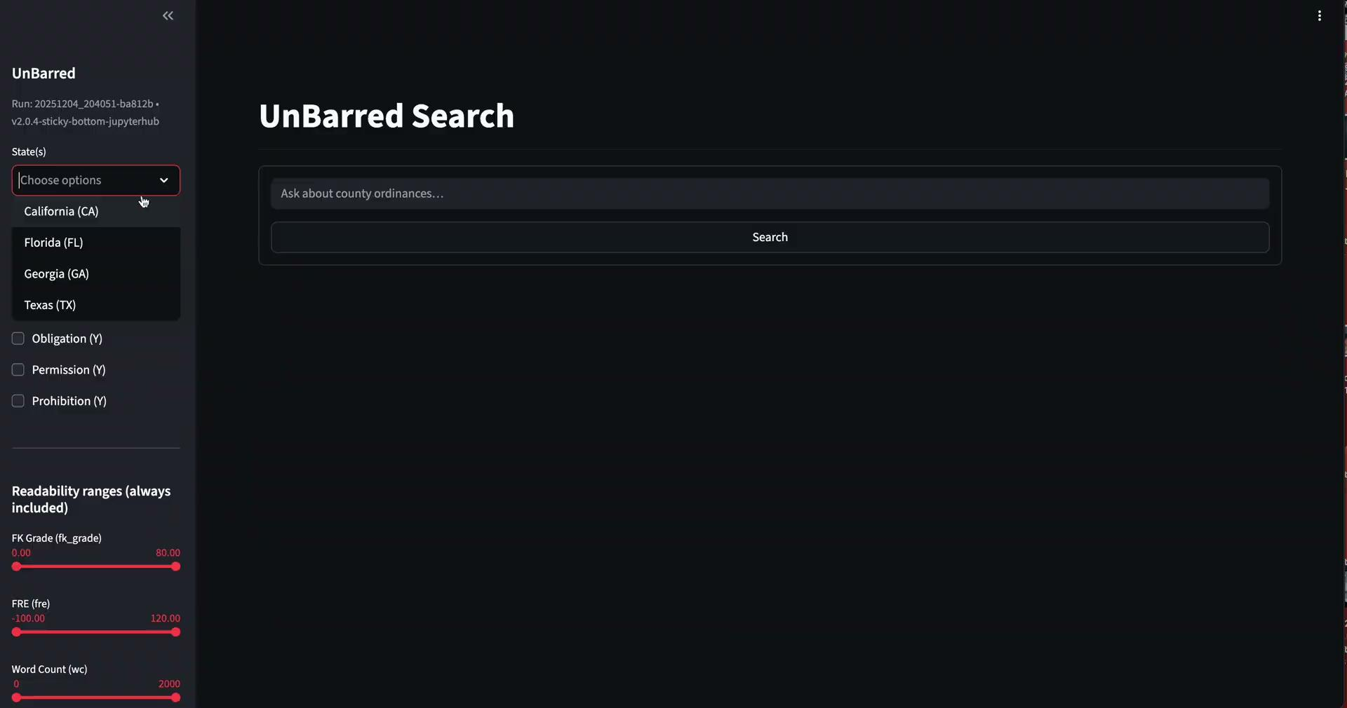
Demo

Slide 6
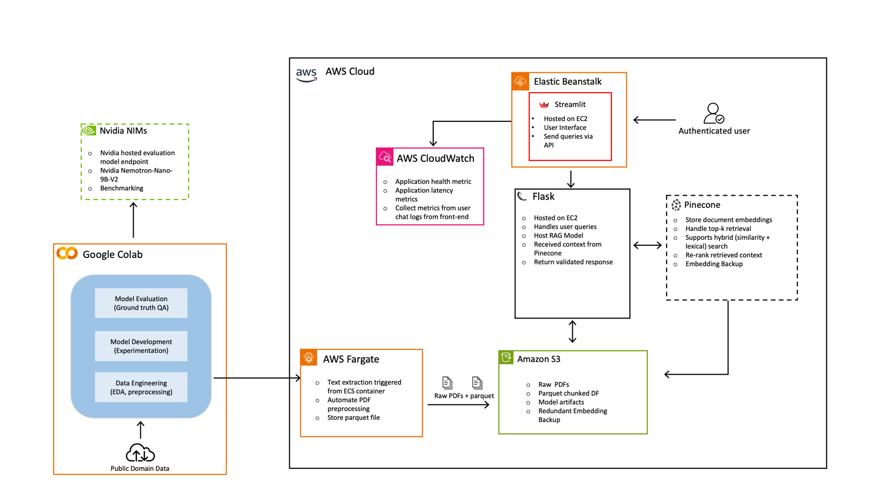
Architecture Overview
A modern tech stack, integrated into a scalable RAG System
Notes:
Sammy
Speaker notes: Here we step back and illustrate to showcase a comprehensive overview of our end-to-end production system
To the left of the diagram, we have our offline, Google Colab environment covered in our data pipeline, where we run our data engineering, model development, and model evaluation.
Data flows into AWS, where Fargate extracts and preprocesses our PDFs, storing both raw data and Parquet files in S3
Our backend uses flask to handles requests from our Streamlit application hosted on Elastic Beanstalk, which then retrieves vectors from Pinecone as context for response generation
AWS cloudwatch is used for logging, and understanding application metrics
Together this create a complete scalable deployment for our RAG system
Foreshadow the other pipeline: data pipeline, retrieval pipeline, evaluation framework
Why did we do this: “ we want to have quality data”
Frontend
Streamlit
Backend
Flask
Data Layer
AWS S3: Storage
Pinecone: VectorDB
Offline Development
Google colab
Evaluation
Nvidia NIMs
Technology Stack
Modern tech stack: Streamlit as frontend and Flask for the backend, integrated into a scalable RAG system
Data Infrastructure
Stored in S3 and indexed for retrieval using Pinecone as VectorDB
Pipeline and Evaluation
Google Colab for offline development
AWS Fargate for ETL processes, and
Nvidia NIMs for our evaluation framework

Slide 7
Data Overview
Notes:
Now lets move into the data

Slide 8
Data
A Massive dataset across 4 states and 386 counties
7.6 GB
1.2M+
Dataset Size
Legal Sections Analyzed
414K+
51.6M
Pages Processed
Tokens Extracted
100%
100%
California
Florida
All 58/58 counties.
Complete data from all 67/67 counties.
70%
60%
Georgia
Texas
Representing 110 out of 159 counties.
Covering 151 out of 254 counties.
Image source: https://www.gamma.app
Notes:
Sammy
In total we processed about 7.6GB of municipal legal documents, which amounts to 414 thousand pages and more than 1.2 million legal sections analyzed
during extraction and cleaning we generated about 51 million text tokens giving us a strong base for our embedding model
As a team, we manually validated each document for data quality and reliability
below we visualize our coverage of the 4 states
we completed extraction and processing for all of California and Florida
covering 58 counties for CA and 67 counties for FL
for Georgia and Texas we were able to extract and process 70% and 60%, respectively
Both municode or general code did not offer complete coverage legal ordinances for these states

Slide 9





A Rich, Structured Data Schema
Document Identification
Content Structure
Readability Metrics
doc_id ( String) - Unique document identifier
section ( String) - Legal section reference (e.g., Article)
fk_grade ( Float64) - Flesch-Kincaid grade level score
state ( String) - State jurisdiction
chunk_text ( String) - Extracted text content of the document chunk
fre ( Float64) - Flesch Reading Ease score
county ( String) - County jurisdiction
pct_complex ( Float64) - Percentage of complex words in the text
page ( Int64) - Starting page number of extracted content
wc ( Int64) - Word count of the chunk_text
end_page ( Int64) - Ending page number of extracted content
summary ( String) - AI-generated summary of the chunk_text
Legal Classification Flags
File Management
obligation ( String) - Indicators of mandatory actions or duties
raw_pdf_path ( String) - Full path to the original source PDF file
permission ( String) - Indicators of granted rights or allowances
prohibition ( String) - Indicators of forbidden actions
penalty ( String) - Indicators of consequences for non-compliance
Image source: https://www.gamma.app
Notes:
Sammy
Next we cover our schema use in our RAG system
First we have document identifiers, these columns represent the doc_id, state, and county description, along with starting and ending page number
next, we have content structure, these represent the chunk_text, references to the legal section of the chunk, word count, and a LLM generated summary of the chunk
additionally, we represent the readability metrics of each chunk
these are important for researcher who want to conduct comparative state by state or county by county analysis
These NLP metrics measure the complexity of legal texts
next, is our legal classification flags, which are especially important for semantic retrieval. We tag each chunk with 4 boolen flags based on the term present in the text chunk.
Obligation represent if terms like “must”, “shall”, or “required” appear in the text chunk
Permission represent the terms “may”, “authorized”, or “can”
Prohibition represents the terms “ may not”, “shall not”, or “prohibited”
Lastly, the penalty flag represent if chunk mentions fines or penalty enforcement
finally, raw_pdf_path ties each chunk back to the original source documents stores in a S3 bucket

Slide 10
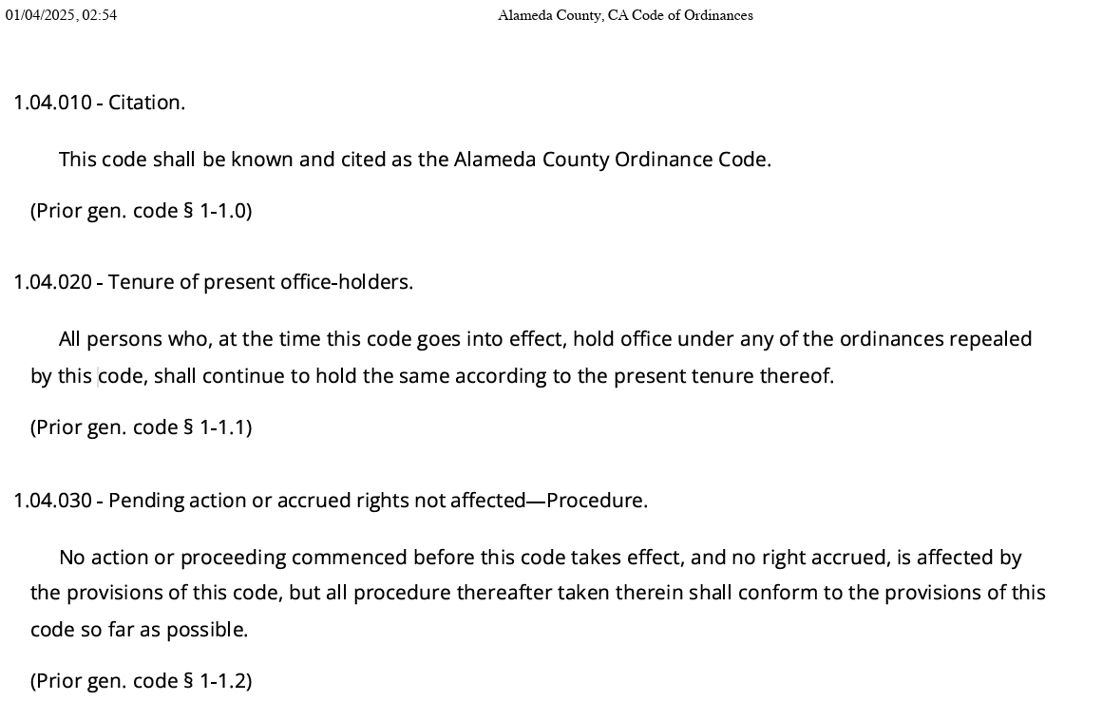
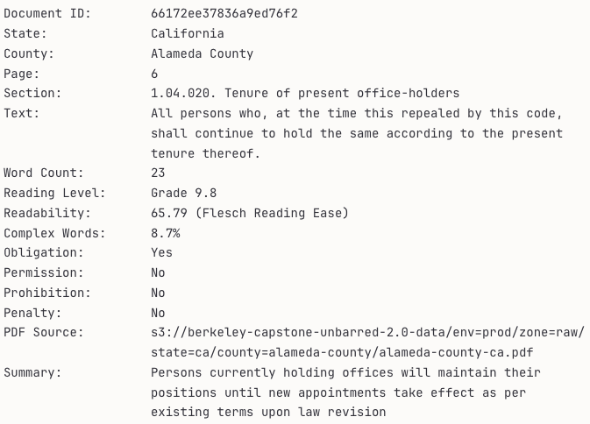
Sample Data: Transformation to Structured Legal Chunks
Notes:
Sammy
here is a sample of our transformation
on the left is the raw pdf contents from Alameda county where each section contains different ordinances
we have section 1.04.010 with a citation ordinance
section 1.04.020 covering tenure of present office holders
and section 1.04.030 covering pending action and accrued rights
After our tranformation, section 1.04.020 would be processed and converted to a text chunk
where we use our schema to generated a complete metadata field to enrich our retrieval

Slide 11
Technical Approach
Notes:
Now lets talk about our technical approach

Slide 12






The Four-Stage Data Pipeline
Data
ETL
Embedding
Evaluation
Collect PDFs + metadata
Store raw files in S3
AWS Fargate extraction
EDA
Data cleaning + chunking
Metadata schema
Store preprocessed parquet files
Generate embedding
Attached metadata fields
Upload vectors to Pinecone
Back up embedding with Pinecone & S3
Pipeline development
Benchmark retrieval
Evaluations
Track metrics
Selenium WebDriver
Google Colab
Pinecone
Notes:
Sammy
Moving on to the data pipeline
This diagram illustrate our offline data flow , which transforms our dataset of PDF documents into embedding used in our RAG system and evaluation framework.
We start by ingesting the documents scraped from Municode and General Code using Selenium WebDriver.
The raw data is uploaded to AWS S3 general-purpose bucket managed by our architect.
Our ETL stage utilizes AWS Fargate service for text extraction.
from there we implement custom chunking logic and preprocess the documents to generate the dataframe schema mentioned before.
The preprocessed data are checkpointed in parquet format for efficient storage and to be used for embedding generation.
We generate our embedding using Pinecone hosted embedding models to create a hybrid search index, attaching metadata fields, and storing a backup for redundancy.
Finally, in our evaluation stage, we build out our RAG pipeline and run ground truth evals for retrieval and performance benchmarks.

Slide 13



Vector Database: Pinecone
AWS S3 Vectors ❌
AWS OpenSearch ❌
Pinecone ✅
Preview status only
Excellent cost-performance balance
High operational costs
Lacks hybrid search capabilities
Proven reliability in production environments
Budget constraints for long-term use
Limited feature set and scalability
Complexity in management
Advanced hybrid search capabilities
For our application, Pinecone stands out as the optimal choice. Its blend of low-latency, reliability, and production-ready feature set directly addresses our specific needs for advanced search and reliable data management.
Image source: https://www.gamma.app

Slide 14

RAG Pipelines
Baseline: Semantic Search on Raw Text Chunks
Pinecone
Semantic Search
Top 5 Results
LLM Generation
Query
Advanced: Hybrid Search + Reranking
Pinecone
Top 5 Ranked Results
Hybrid Search
Top 100 Results
Re-ranking
LLM Generation
Query
Notes:
Roz

Slide 15
Pipeline Details
 |  | Semantic Search (Baseline) | Hybrid Search + Reranking
Embedding Model | Dense (Semantic) | llama-text-embed-v2
 | Sparse (Keyword) | x | pinecone-sparse-english-v0
Re-ranker |  | x | cross-encoder/ms-marco-MiniLM-L-6-v2
Generator LLM |  | Llama-3.1-8B-Instruct with 4-bit quantization
Notes:
Roz

Slide 16
Example
Ground Truth:
Section: Sec. 30-1. Answer: Notwithstanding any other provision of this [state] constitution, Fulton County may, with the consent of the city involved, operate recreational programs in any city lying wholly or partially within such county and having a population of 5,000 or less, according to the present or future United States census.
How do population changes affect county-city collaboration (Fulton, GA) ?
Query
 | Baseline | Advanced
Top 5 chunks | Sec. 50-3. Sec. 46-41. Sec. 34-146. Sec. 34-147. Sec. 62-160. | Sec. 34-147. Sec. 34-146. Sec. 30-1. Sec. 158-76. Sec. 22-1.
LLM Answer | The law does not directly address … However, it does provide some relevant information on the powers and limitations of counties and municipalities in relation to each other. | The law in Georgia does not directly address …However… [Chunk 3] discusses the operation of recreational programs in cities with less than 5,000 population. It states that Fulton County may operate recreational programs in such cities with the consent of the city involved. This implies that population changes can affect the collaboration between cities and counties in terms of recreational programs...
Notes:
Roz

Slide 17
Evaluations

Slide 18
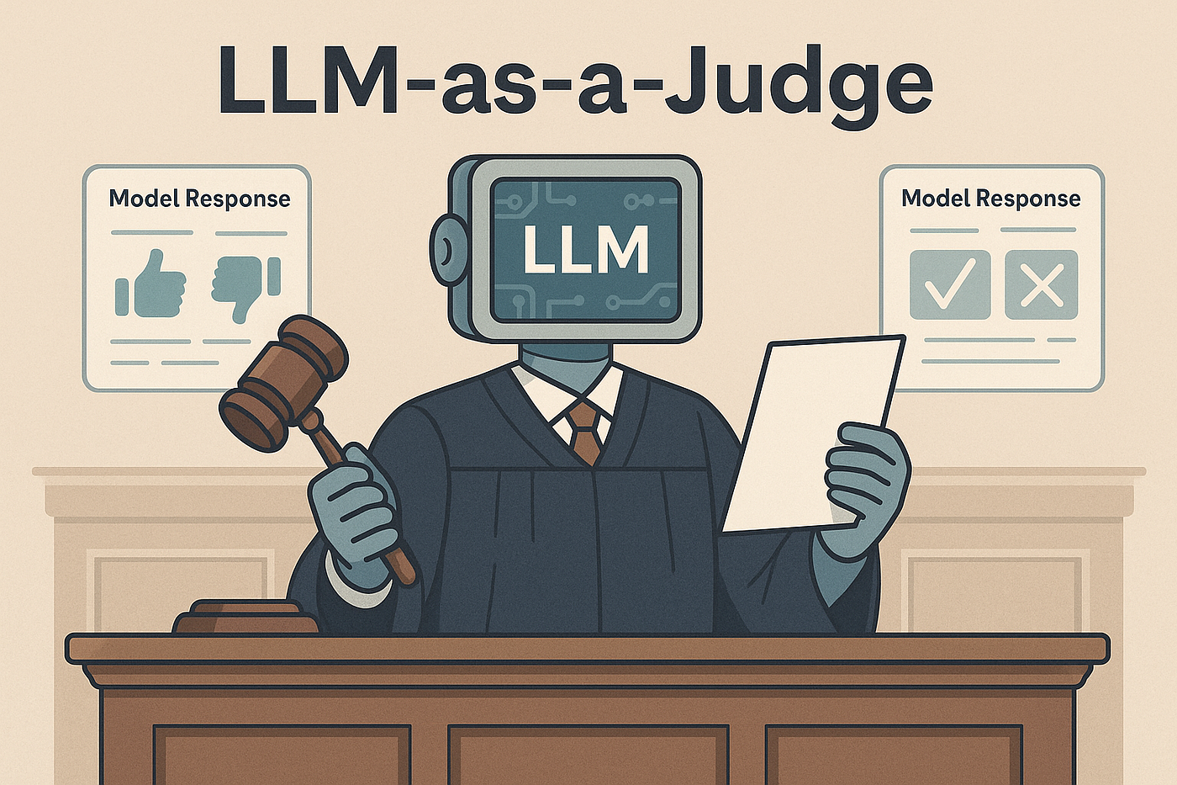
Evaluation Framework
Goal: Evaluate retrieval, ranking, and metadata performance of our AI-powered law retrieval engine
Method: LLM-as-a-Judge using NVIDIA Nemotron-Nano-9B-v2 (NIMs API)
Dataset: Golden Truth benchmark (Easy / Medium / Hard levels across states & counties)
Focus areas:
Correctness of retrieved laws
Ranking relevance
Chunk coverage & completeness
Metadata accuracy & readability metrics
Notes:
Arthur

Slide 19
Golden Truth Dataset
Scope | Structure
4 states (CA, GA, FL, TX) Deep county coverage (e.g., Alameda County) Includes negative examples (no valid law exists) | Researcher query Verified “golden law” chunk Difficulty label (Easy / Medium / Hard) Metadata fields for evaluation (title, flags, readability)
Notes:
Arthur

Slide 20
LLM as a Judge Process
1
Research Query
e.g., “In Alameda County, CA are dogs allowed to run in public”
2
AI-Powered Law Retrieval Engine
Retrieve top-5 relevant law chunks from dataset + metadata
3
Golden Truth Reference
Known correct law section from dataset
4
Nvidia NIMs API
Nvidia Nemotron-Nano-9B-V2 judge compares retrieved chunks vs ground truth, analyzing metadata & chunking
5
Scoring output & rationale
Accuracy, ranking, chunk quality, score

Slide 21
Metrics and Scoring
Category
Metric
Purpose
Retrieval Accuracy
Top-5 Recall
Checks if the golden law appears among five retrieved chunks
Ranking Quality
Mean Reciprocal Rank (MRR)
Measures how high the correct law appears
Chunking Quality
Coverage Score
Evaluates whether full legal section is captured
Metadata Accuracy
Flag Correctness
Validates regex-based flags ("prohibited," "must," "penalty," etc.)

Slide 22
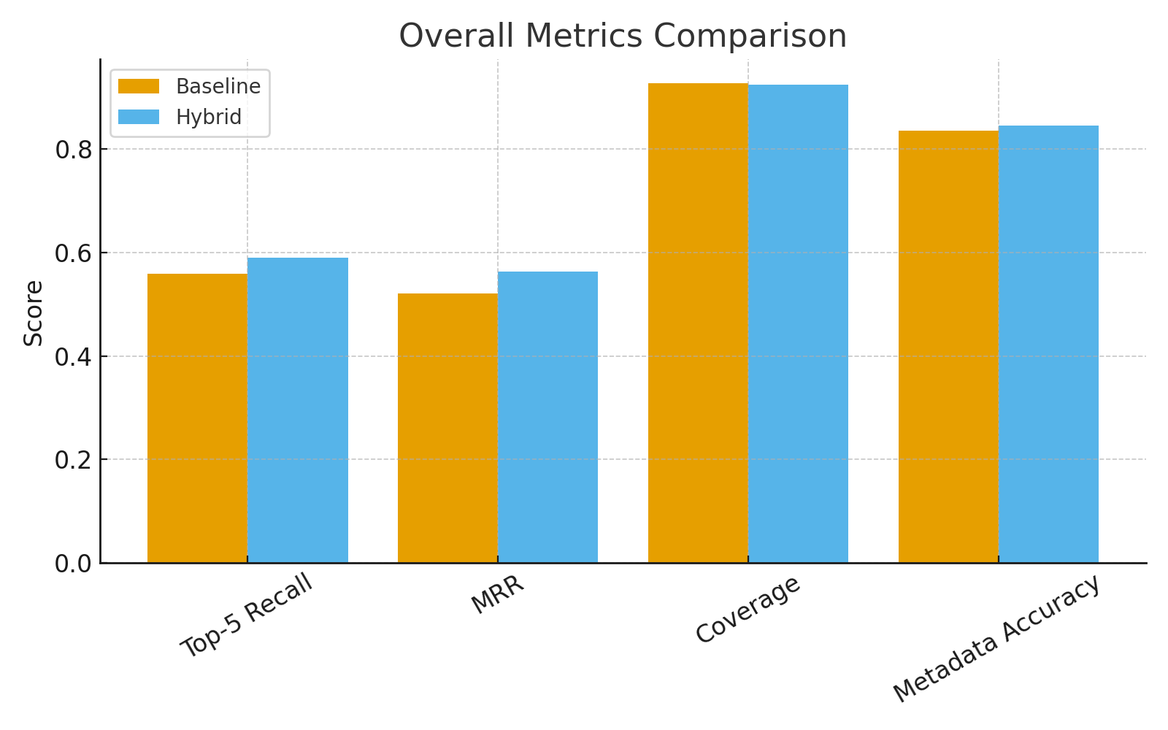
Overall Metrics
Metric | Baseline | Hybrid | Difference
Total Queries | 95 | 95 | —
Found in Top 5 | 53 | 56 | +3
Top-5 Recall | 55.8% | 58.9% | +3.2%
MRR | 0.521 | 0.563 | +0.042
Avg Chunk Coverage | 0.927 | 0.923 | -0.004
Avg Metadata Accuracy | 0.835 | 0.845 | +0.009
Negative cases recognition | 1.000 | 1.000 | —

Slide 23
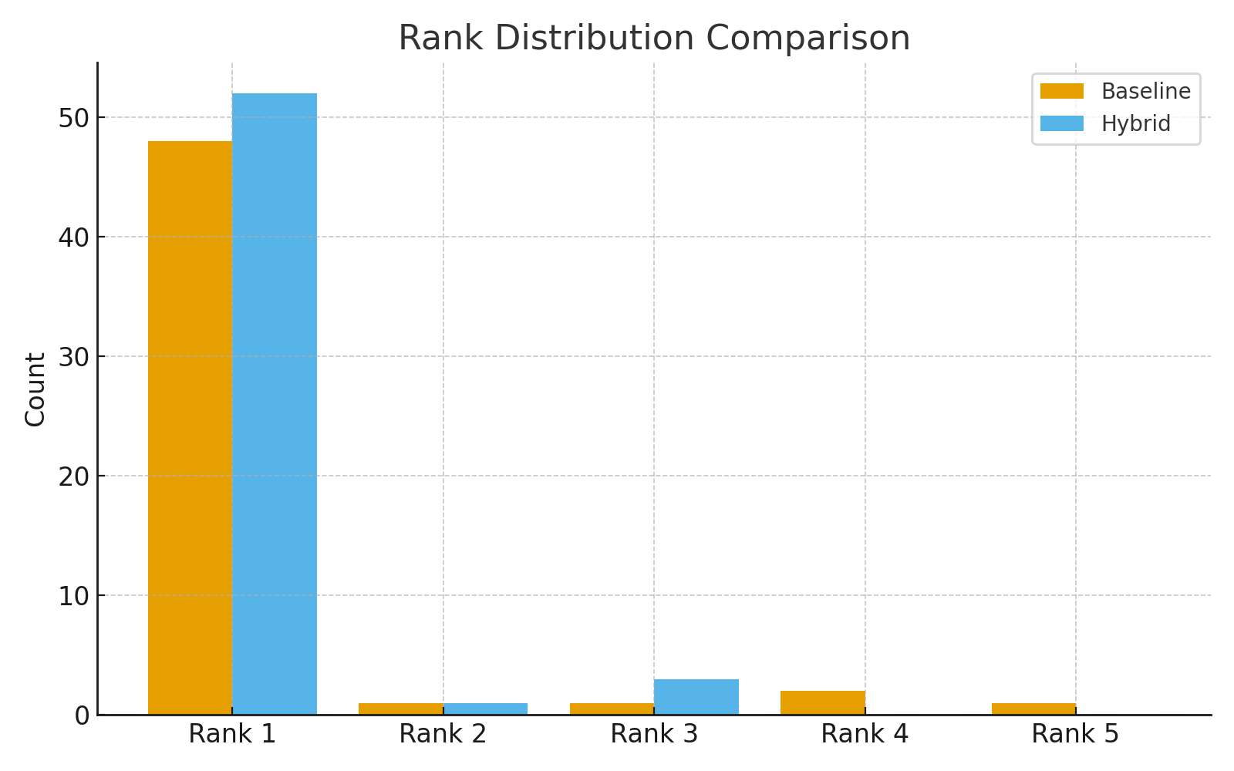
Rank Distribution and Performance by Difficulty
Rank | Baseline | Hybrid | Difference
Rank 1 | 48 | 52 | +4
Rank 2 | 1 | 1 | 0
Rank 3 | 1 | 3 | +2
Rank 4 | 2 | 0 | -2
Rank 5 | 1 | 0 | -1

Slide 24
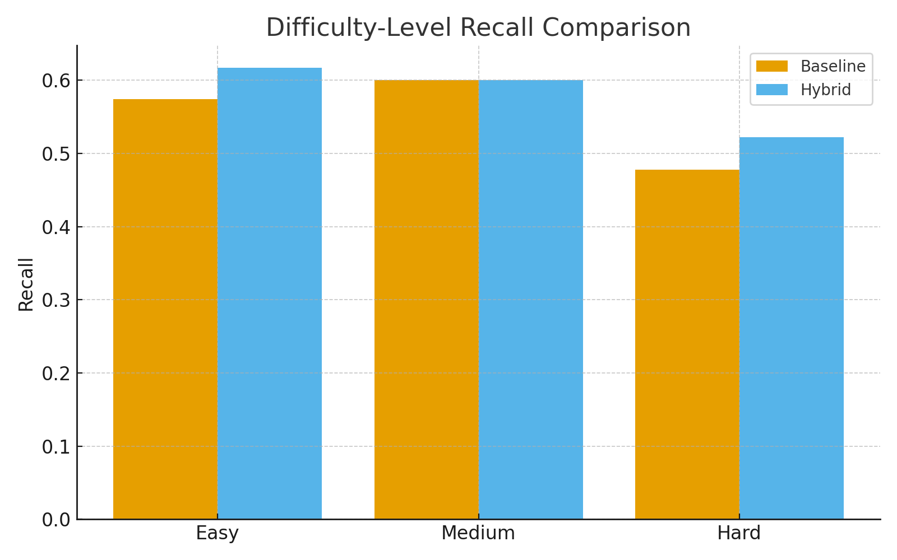
Rank Distribution and Performance by Difficulty
Difficulty | Count | Baseline Recall | Hybrid Recall | Diff
Easy | 47 | 57.4% | 61.7% | +4.3%
Medium | 25 | 60.0% | 60.0% | 0.0%
Hard | 23 | 47.8% | 52.2% | +4.3

Slide 25
Summary & Future Work
Notes:
Now to the last section of our presentation where we will summarize what we accomplished and the road ahead.

Slide 26
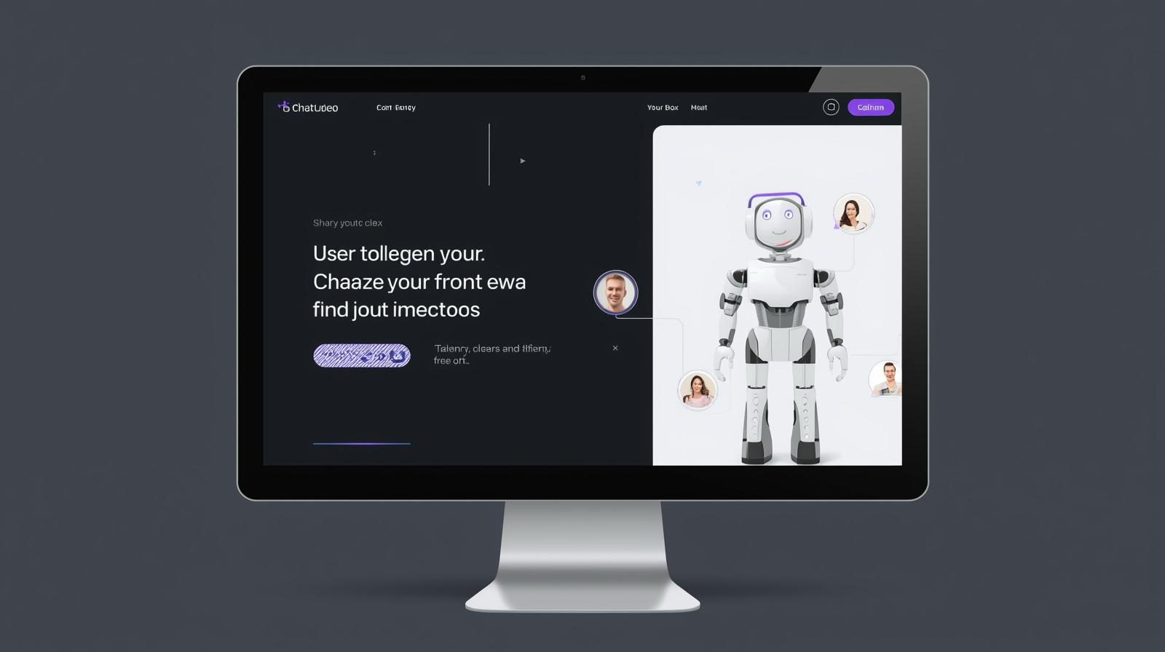
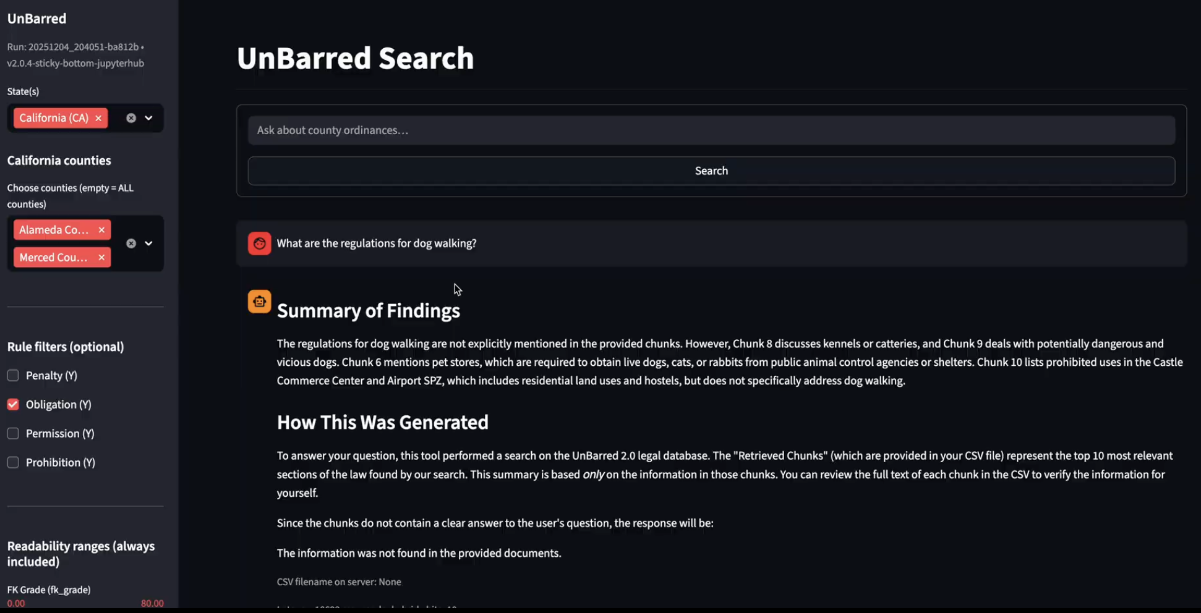
What We Delivered and Accomplished
Low cost, containerized RAG system.
Semantic search across 400K pages of legal code.
Reduce hours of research and comparison to minutes
Notes:
We delivered production-ready and low cost RAG (Retrieval-Augmented Generation) system enabling semantic search across 400K+ pages of legal ordinances from 400+ counties across California, Florida, Georgia, and Texas. The system can help Berkeley researchers find and compare relevant regulations in seconds instead of hours of manual PDF reading.

Slide 27



Key Technical Takeaways & Challenges
Financial Constraints:
Data Engineering:
Extracting, processing, and storing data from 4 states utilizing cloud provider’s services can be extremely expensive.
Challenging to extract high-quality structures in a cheap and scalable way due to the wide variation in document structure across countries and the sheer volume of files.
Front-end:
Creating a seamless user experience vs technical challenges. For example, balancing user requirements for query filter vs filtering in the backend.
Notes:
Throughout the project we faced faced three critical challenges. The first two issues were managing costs while maintaining performance: extracting, indexing, and generating response for over 400,000 pages of legal documents would have been expensive with closed-source or high-end open-source models. So, our solution was to engineer the system around smaller, cost-efficient models without compromising core functionality.
Lastly, we had to prioritize rapid development over extensive UX refinement. The aggressive timeline meant we could only conduct limited user testing rather than the multiple iteration cycles ideal for optimizing user experience.

Slide 28





Future Roadmap
Data Engineering
Experiment with LLM and or regex + positional + text size based pdf text extraction.
Modeling
LLM in the middle for spell checking and metadata extraction for filtering.
Newer models for retrieval and embedding.
Frontend
Additional user testing and feedback on live system.
Upgrade API service to FastAPI
Notes:
Moving forward, there are three key areas we could focus on:
Data Engineering: We could leverage LLMs to perform smarter PDF text extraction that understands document structure—things like headers, tables, and positional context—rather than using regex. This would improve the quality of our ground source truth data.
Modeling: We could incorporate LLMs for query refinement and metadata extraction from user query to improve search accuracy. Additionally, we could evaluate newer open-source models that might offer better performance at similar cost points. This would help address some of the cost-performance tradeoffs we encountered.
Frontend: Conducting additional user testing would allow us to gather more feedback on the live system and iteratively improve the interface. We would also migrate to FastAPI, which would provide better performance and an improved developer experience for future enhancements.
Each of these areas represents an opportunity to build on what we've learned and deliver greater value to users.

Slide 29

Mission
Enable researcher to answer public policy questions grounded in verifiable sources in seconds, not days.
Image source: https://www.flaticon.com/
Notes:
Kevin

Slide 30
Appendix

Slide 31
Challenges & Trade-offs
Financial Constraints:
Cost challenges in extracting, processing, and storing data from 4 states.
Data Engineering:
Challenging to retrieve laws from all 50 states, MVP is 4 states
Challenging to extract high-quality structures in a cheap and scalable way due to the wide variation in document structure across counties and the sheer volume of files
Front-end:
Transitioning from a one-shot query box to a conversational UI
Streamlit re-runs the script on every input
Data layer
S3Vectors and AWS Opensearch have limitation regarding cost and features necessary for MVP
S3Vectors still in preview with no hybrid search
Opensearch cost outside of our budget constraints
Notes:
Biggest challenge was Cost vs Speed vs Quality in terms of the datapipeline. We chose to prioritize Cost and Speed due to the limitation of the budget.

Slide 32
Decision Log
Option → Decision → Evidence
Option: Text/structure extraction via python(regex, PyMuPDF) vs AI/COTS
Decision: Regex
Evidence: High cost of AWS Bedrock and AI.
Option: AWS S3 vectors, Pinecone, AWS Opensearch
Decision: Pinecone
Evidence: Good balance between cost and performance, and the client has kindly sponsored the cost
Notes:
How are we going to extract and preprocess

Slide 33
Slide Resources

